Slide 1

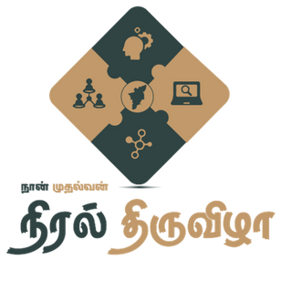


TAMILNADU SKILL DEVELOPMENT CORPORATION
Naan Mudhalvan Niral Thiruvizha Project
Care Connect: Intelligent Healthcare Data Monitoring And Management System
Done by
Guided by
Vanmathi S , Sowndarya K
Vanitha Lakshmi G and Yuvasree C
Department of CSE
Adhiparasakthi Engineering College Melmaruvathur.
Dr. C. Dhaya, Professor and Head
Department of CSE
Adhiparasakthi Engineering College
Melmaruvathur.
Intermediate Review 2
24-04-2024

Slide 2
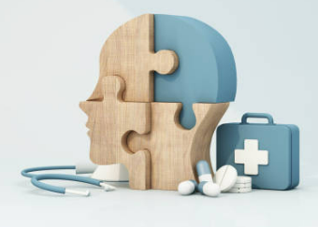

Problem statement from Niral Thiruvizha
To develop analytics for hospitals' health-care data, optimizing data utilization to improve patient care, streamline operations, and enhance overall efficiency in healthcare institutions?
Solution Description
CareConnect: IntelligentHealthcare data monitoring and management system

Slide 3

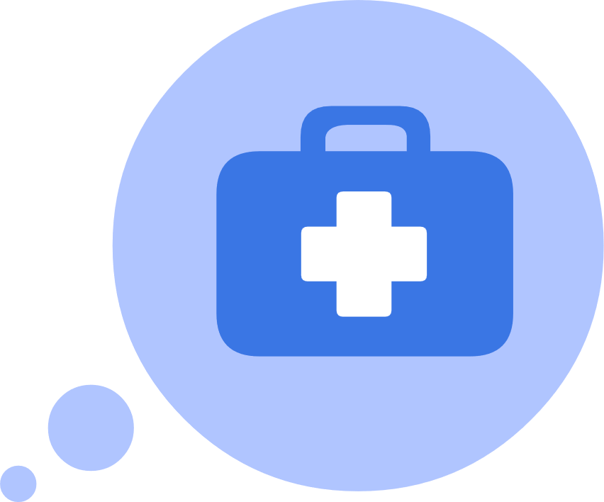

Overview
01
Introduction
05
Working architecture
02
06
Statistics
Module description
04
Objective
08
Conclusion

Slide 4
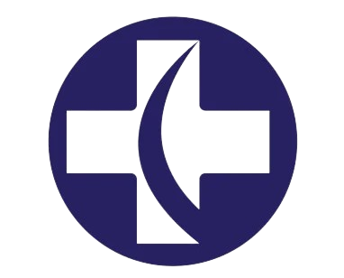
Introduction
In the fast-paced world of healthcare, delays in addressing critical patient needs can have serious repercussions.
These delays underscore the urgent need for advanced analytics and real-time monitoring systems to optimizing healthcare outcomes.

Slide 5

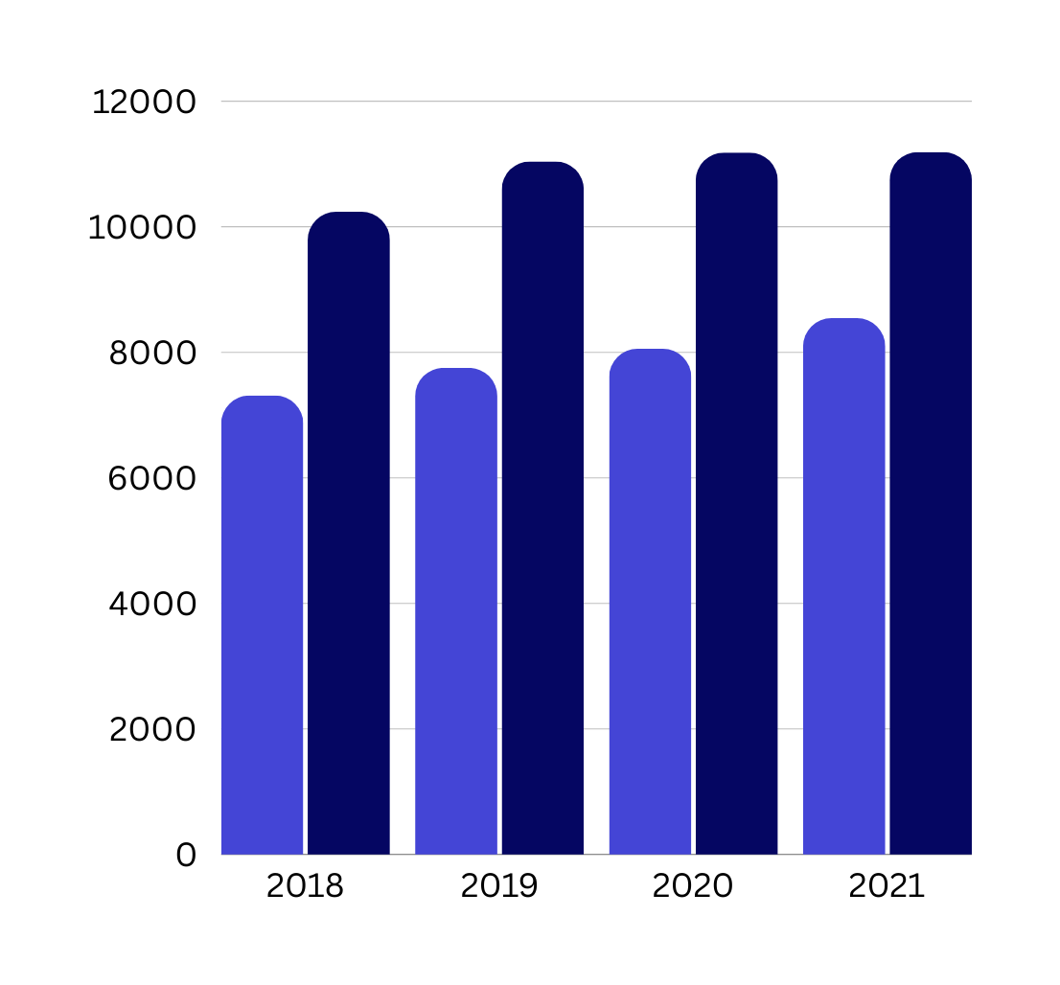
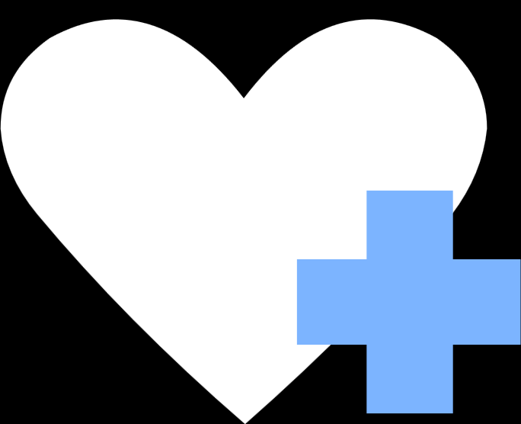
Statistics
The study, conducted at the All India Institute of Medical Sciences (AIIMS) and (ICMR), New Delhi, stated that 55 per cent of the cardiac/stroke deaths reported in India are due to delay in seeking care.
The study conducted in Punjab and India, analyzed maternal deaths between 2017 to 2020. This study founds 57.6% of death caused due to delay

Slide 6

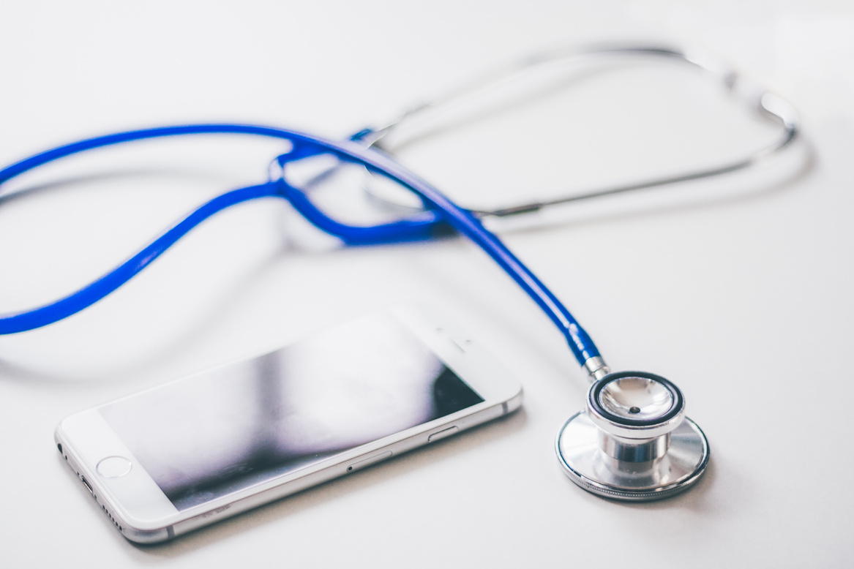

How Our solution differs
Existing solution
Our solution
The vital signs of patients are only be monitored and send alerts to the authorized persons
Along with vital signs gathering, status of nurse and drug recommendation system also be developed to streamline the operations

Slide 7
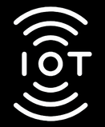

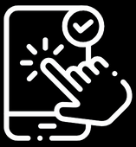
Objective
1. To develop a continuous real-time monitoring and alerting system for patients and to develop non-contact attendance tracking system for staff nurse.
2. To develop a recommendation system to recommend the right medicine with right dosage at right time
3. To develop an UI the real-time monitoring and alerting system , attendance tracking system and recommendation system

Slide 8
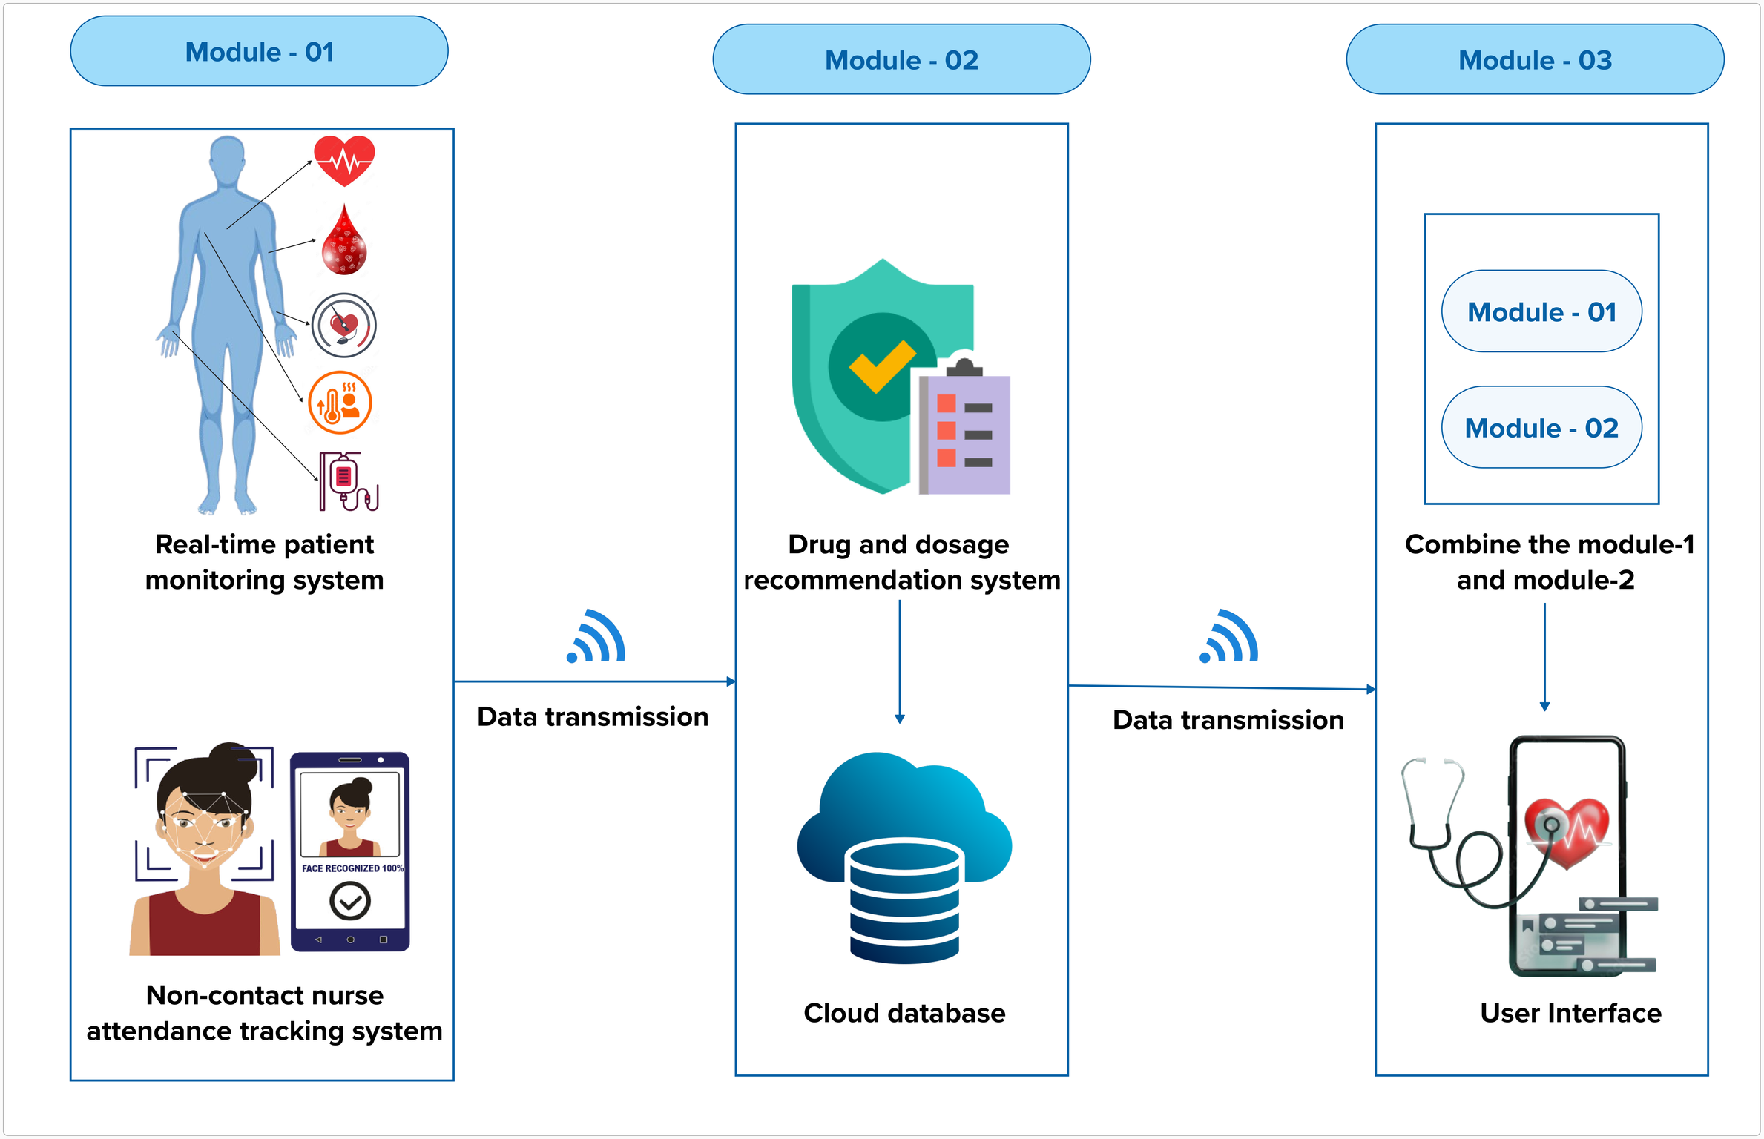
Architecture Diagram

Slide 9
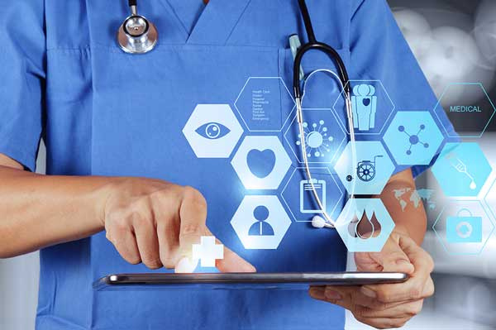
Conclusion
Our solution develops a platform for real-time patient monitoring and staff attendance tracking, ensuring timely interventions and improving operational efficiency in healthcare institutions.
Our application alerts nurses to abnormal conditions and recommends precise treatments, revolutionizing patient care with enhanced accuracy and speed in treatment decisions.

Slide 10

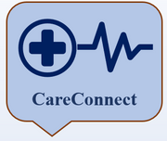
CARE CONNECT
Thankyou !!

